Slide 1
Trend Event Pattern Mining
Talha Farhat
Abdul Hadi

Slide 2
Overview
Overview
1. Problem Statement
2. Introduction
3. Methodology
4. Results
5. Demo
6. Future Work

Slide 3
Problem Statement
Develop a trend-event pattern mining framework that can aid in personalized treatment/prognosis.

Slide 4
Introduction

Slide 5
Introduction
Objective: Develop a trend-event pattern mining framework that aids in personalized treatments based on patient data.
Focus: Analyze vital signs and medication events to derive insights for prognosis models.
Data Sources: Electronic Health Records (EHR) data including vitals, medications, and lab results.

Slide 6
Key Ideas from Literature
Recent Readings close to an Event (medication, Operations) carry more validity for observing a trend
To find efficacy of a treatment, look for trends before and after the treatment to validate wheter it had a positive or a negative impact on the observed metric.

Slide 7
Adopted Approach
In EHR, medications and lab/vitals are readily available for a large number of patients.
Adopted Approach:
Find All possible Trigrams for Each Patient
(Vital Reading Before, Medication prescribed, Vital Reading After)

Slide 8
Methodology

Slide 9
ETL

Slide 10
ETL Process
The first step
Initial problem was loading all the patients info at once
Led to memory error
Solution: load data by converting it into chunks using pandas and save it as a csv
Saves the trouble of accessing mongo server time and again

Slide 11
Data Cleaning

Slide 12
Data Cleaning
Standardizing vitals data:
BMI was miscalculated due to some height and weight readings being taken in pounds and inches
Converted these to SI Units by observing abnormal values in the BMI column
Cleaned Mean Arterial Pressure by clipping values on 3 IQR based on consultation with doctor

Slide 13
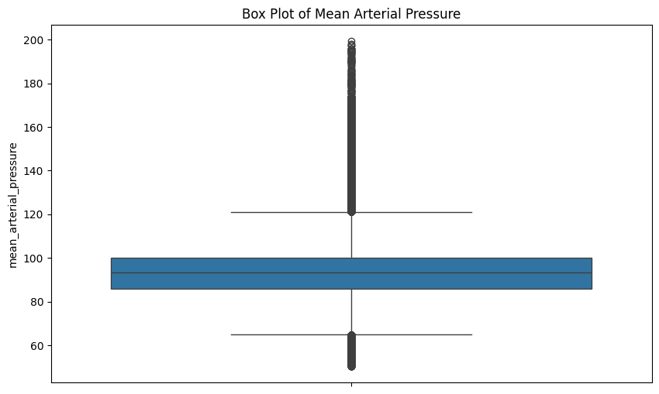
Clipping Outliers

Slide 14
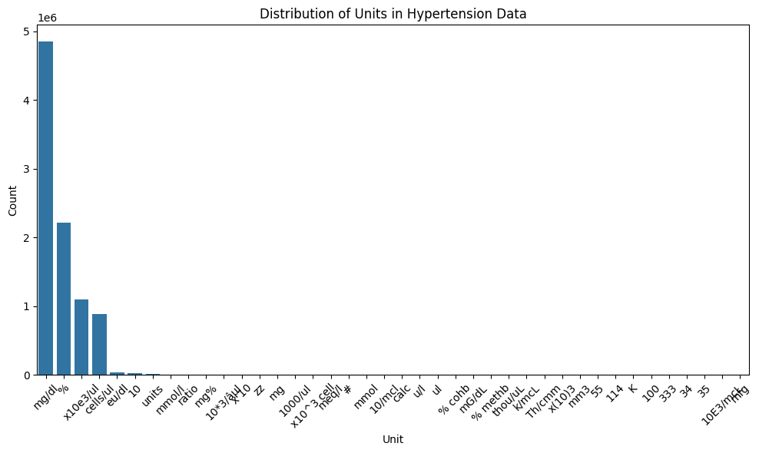
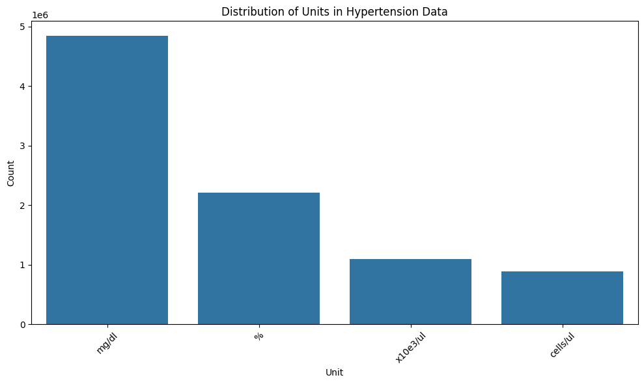
Standardization of units for Labs
Units of Extracted Labs Before Cleaning
Units of Extracted Labs After Cleaning

Slide 15
Tuple Extraction

Slide 16
Tuple Extraction
The extracted vitals and medications df are used in unison
We find the latest lab/vital reading for each patient.
Then we find the lab reading that immediately precedes the latest one.
If found, look for medication prescribed in between.
Final Representation
(patient_ID,
measured_metric_name,
Days Before,
Value_before_mediation,
Med_GPI_Code,
Days After medication,
Value_after_medication)
Example
(1234,MAP,182,5.4,39400000,18,6.7)

Slide 17
Abstraction

Slide 18
Abstraction : Idea
EHR is noisy and inconsistent
Common idea persistent in literature is to abstract values into categories so that noisiness can be overlooked
Two types of abstraction is common:
Vital /Lab Value Categorization
Temporal Abstraction

Slide 19
Value Categorization

Slide 20
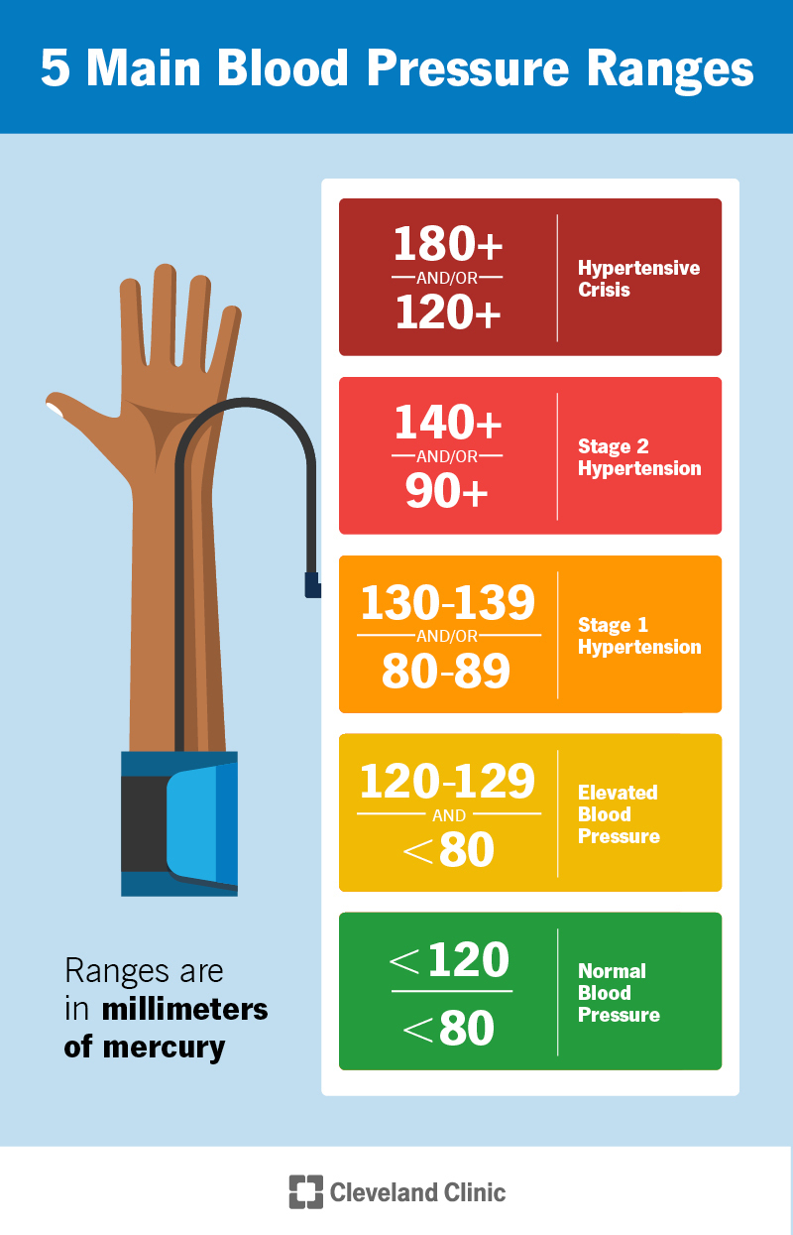
Observed Metric Abstraction
Classify Values into Categories using defined ranges in medical domain knowledge
The categories for each different lab/vitals were verified by doctors

Slide 21
Temporal Abstraction

Slide 22
Temporal Abstraction : Idea
Readings that occur closer to the medication event provide stronger support for identifying the underlying trend.
Quantify the recency of observed metric based on the above hypothesis

Slide 23
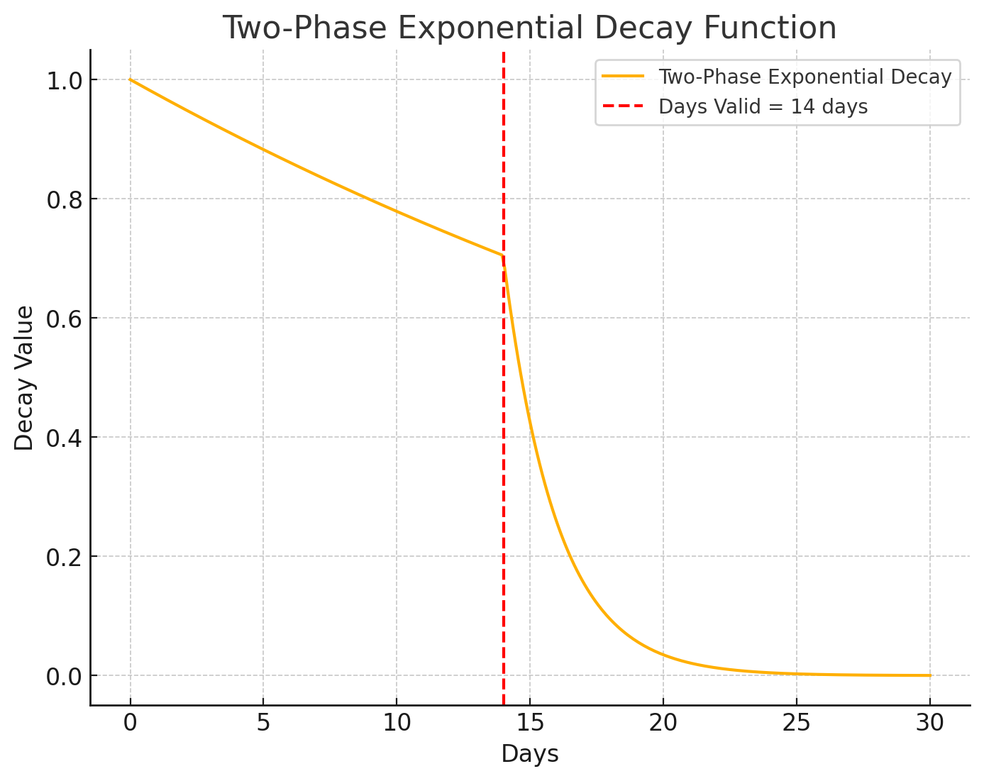
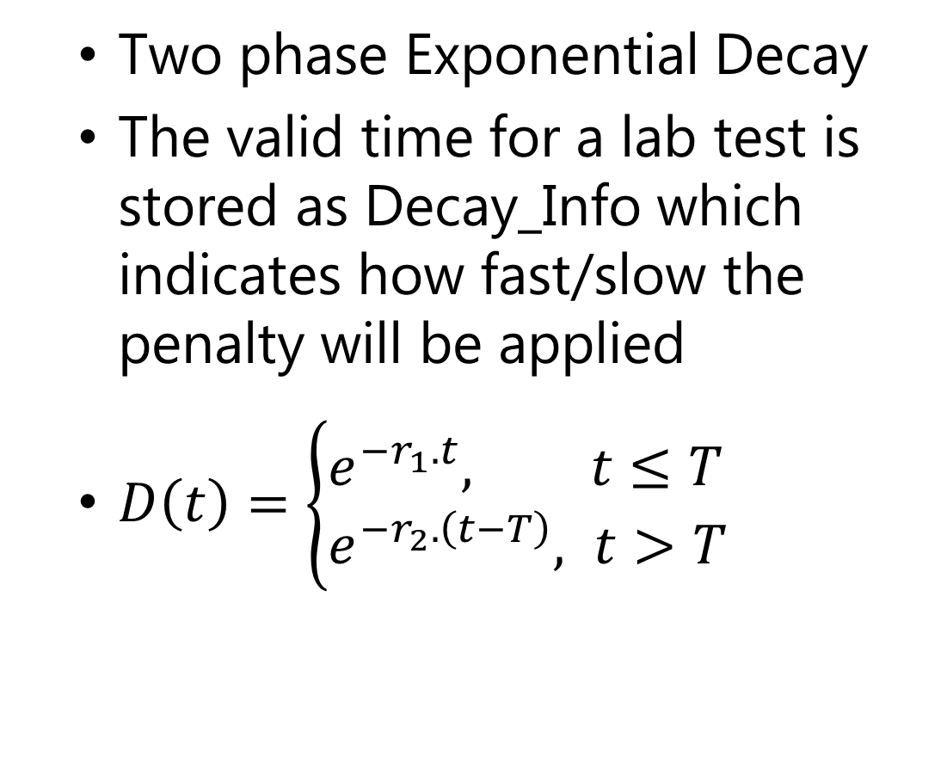
Penalty Based on Recency
Two phase Exponential Decay
The valid time for a lab test is stored as Decay_Info which indicates how fast/slow the penalty will be applied
$D\left(t\right)=\left\{\begin{aligned}&e^{−r_{1}.t}, t≤T \\ &e^{−r_{2}.\left(t−T\right)}, t>T\end{aligned}\right.$

Slide 24
Temporal Abstraction : Categorization
Approach 1
Apply penalties and bin the outcomes based on their values
Bin values (0-0.3), (0.3-0.6), (0.6-1.0)
Fault
not interpretable
Too many Categories after Grouping

Slide 25
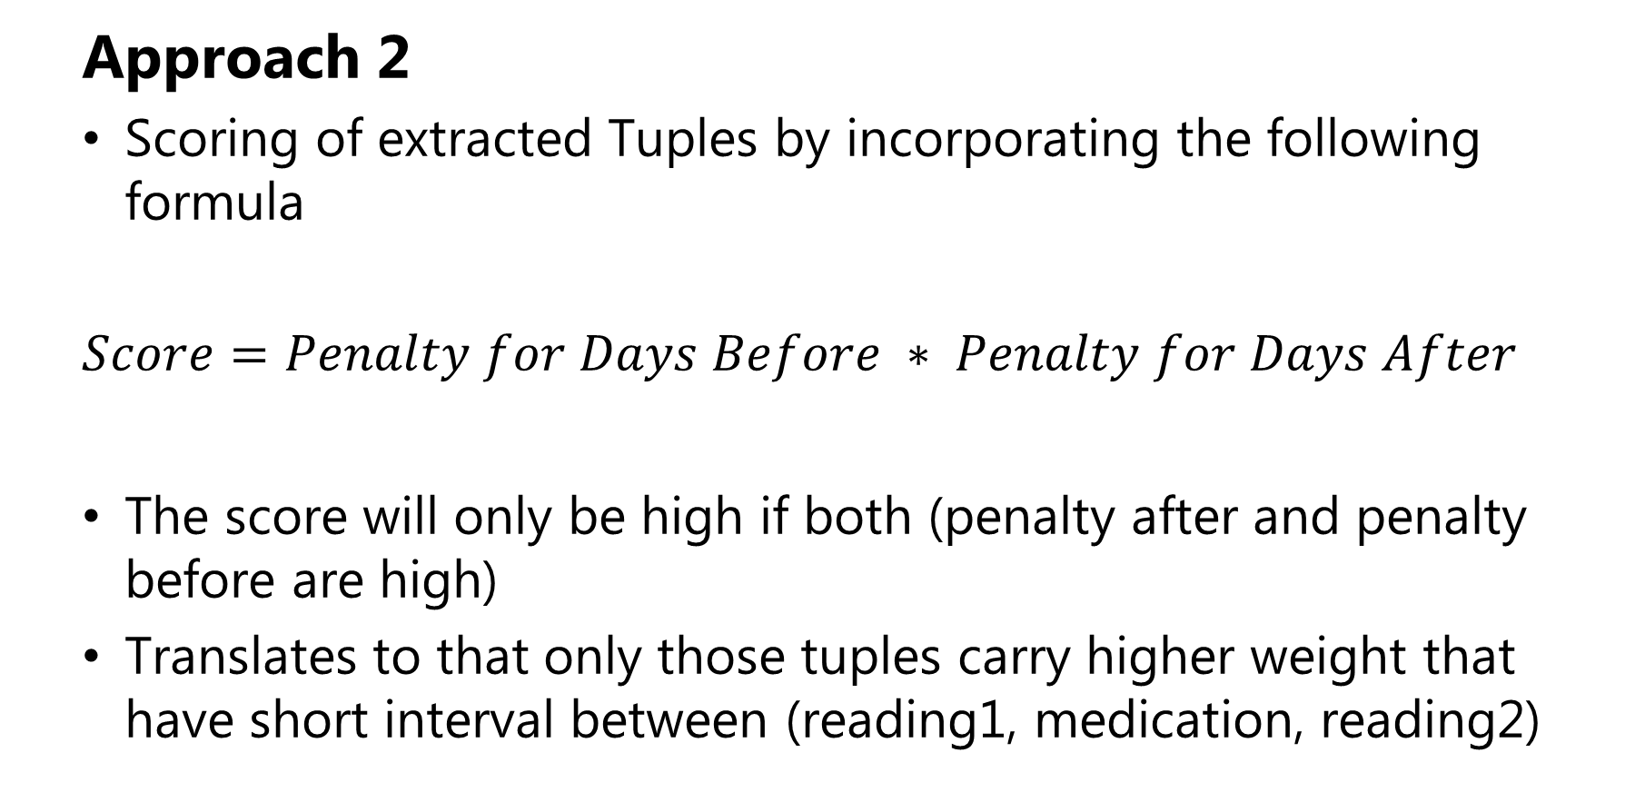
Temporal Abstraction : Idea
Approach 2
Scoring of extracted Tuples by incorporating the following formula
$$Score=Penalty for Days Before ∗ Penalty for Days After$$
The score will only be high if both (penalty after and penalty before are high)
Translates to that only those tuples carry higher weight that have short interval between (reading1, medication, reading2)

Slide 26
Grouping Based on Trends

Slide 27
Grouping on Trends
All the extracted and categorized results are finally grouped to view the desired Patterns
The extracted dataframe is grouped by the following parameters GPI_CODE & Cat_Before & Cat_After.

Slide 28
Grouping on Trends
Aggregation of the penalty scores is done by adding all the scores together that fall under the grouping done above.
Another column, Count, depicting the total observed occurrences of the grouping is added as a support for the observed score.

Slide 29
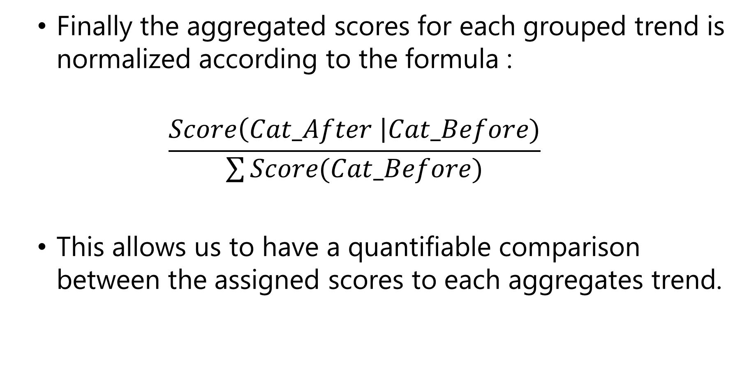
Grouping on Trends
Finally the aggregated scores for each grouped trend is normalized according to the formula :
$$\frac{Score\left(Cat_After \right|Cat_Before)}{\sum{Score(Cat_Before)}}$$
This allows us to have a quantifiable comparison between the assigned scores to each aggregates trend.

Slide 30
Explainability

Slide 31
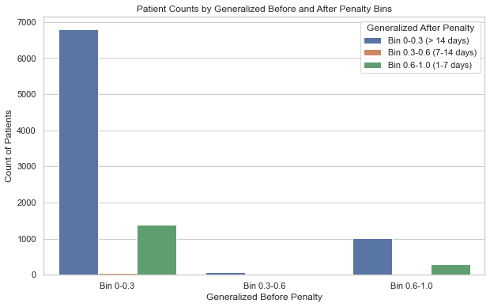
Grouping on Trends
The process of abstractions has the downfall of losing explainability
This aspect is catered for allowing the doctor to see a detailed view of the patient cohort that led to the score of each tuple

Slide 32
Results

Slide 33
Hypertension Results
For detailed analysis, we focused on Mean Arterial Pressure of Patients Diagnosed with Hypertension
Total number of patients present : 450 K
No. of valid tuples extracted : 3.3 M
After Grouping based on Trends : 22 K

Slide 34
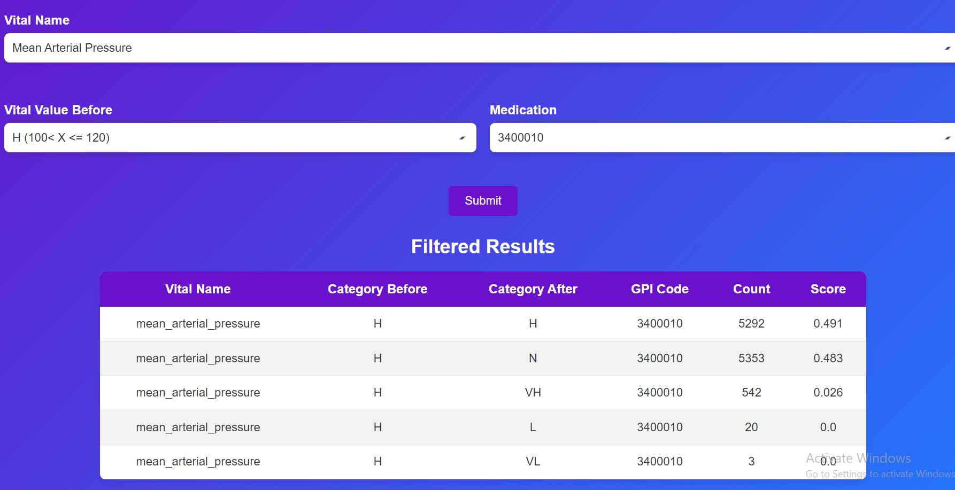
Hypertension Results
3400010 medicine helped lower the mean arterial pressure from High to Normal more than 5000 times.
The prescribed drug belongs to calcium blockers that help in stopping calcium from entering the blood vessels.

Slide 35
Results
Further detailed analysis for each disease can be conducted to verify the efficacy of each drug against the current condition of the patient

Slide 36
Triple Extraction Evaluation
Design

Slide 37
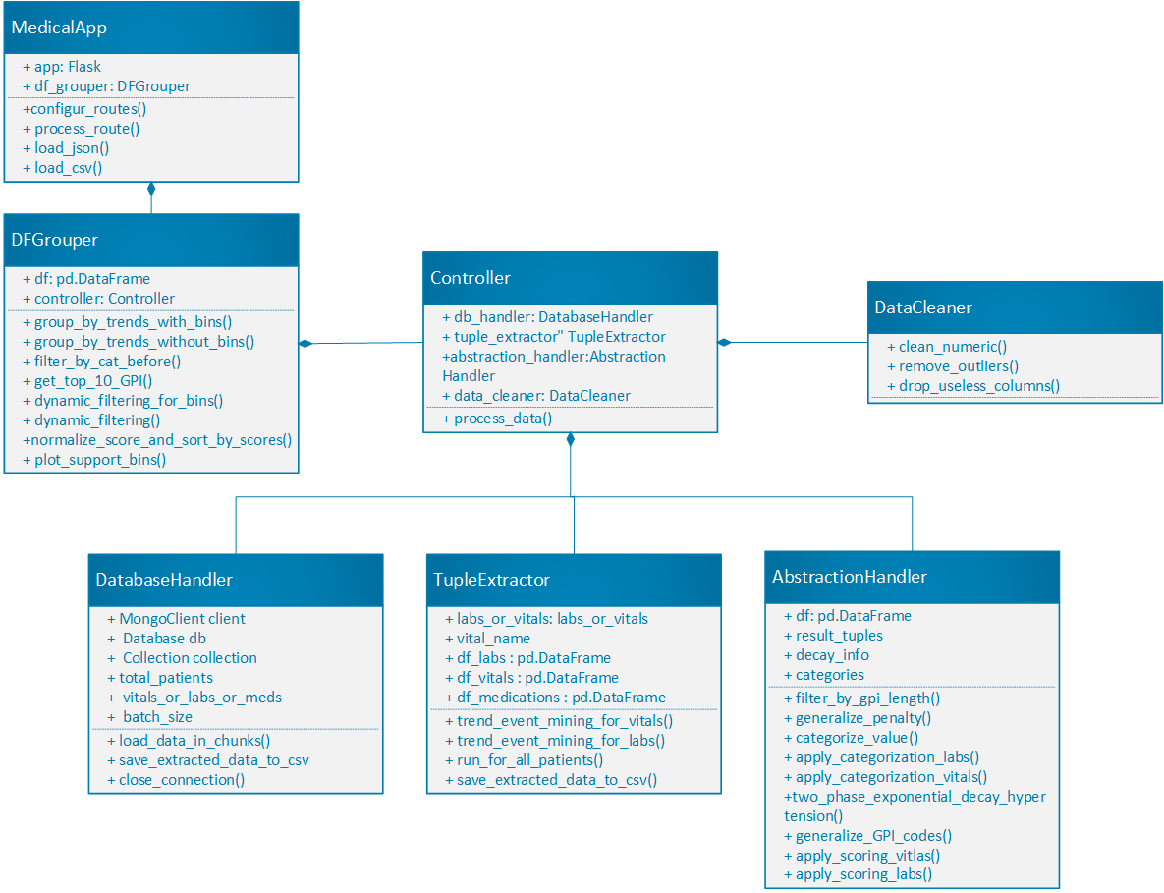
Triple Extraction Evaluation
Class Diagram

Slide 38
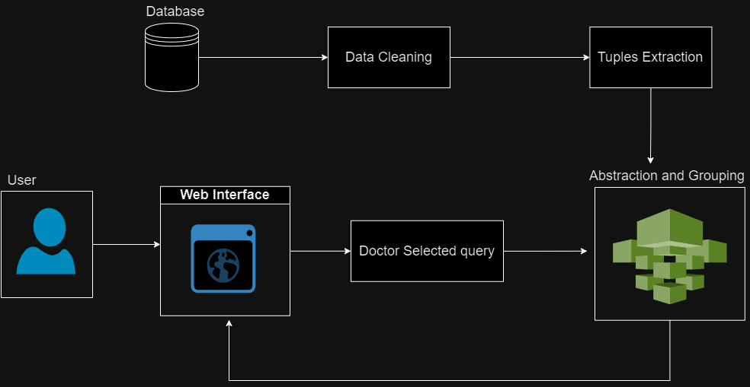
Architecture Diagram

Slide 39
Proposed Deployment Environment

Slide 40
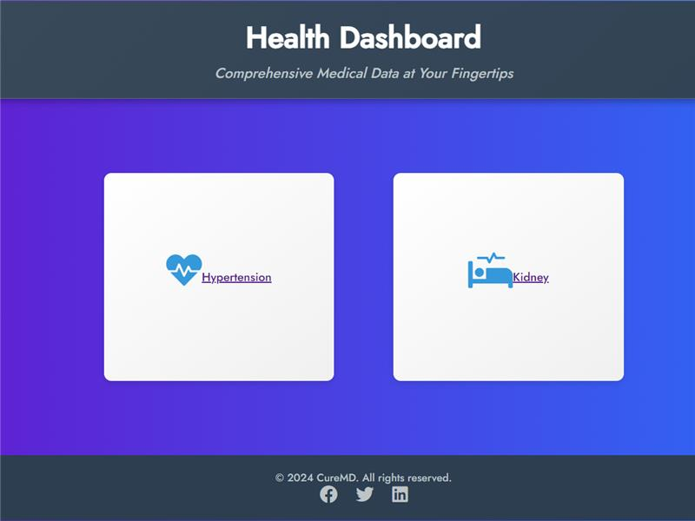
Doctor’s Dashboard

Slide 41
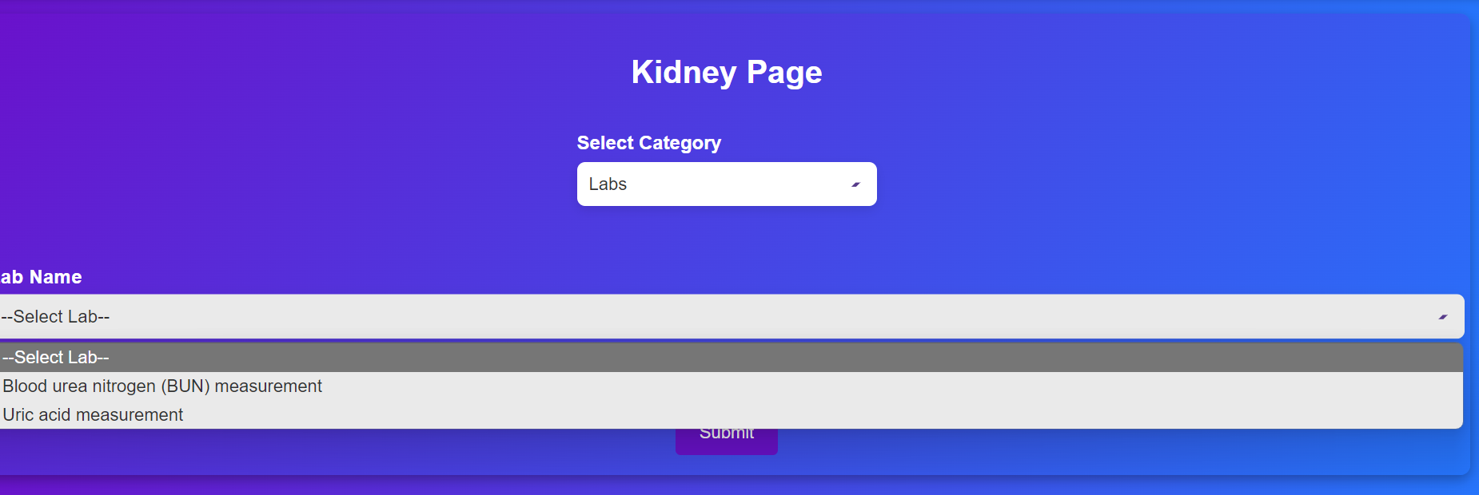
Doctor’s Dashboard

Slide 42
Doctor’s Dashboard

Slide 43
Triple Extraction Evaluation
Demo

Slide 44
Triple Extraction Evaluation
Future Work

Slide 45
Future Work
Get validation of the results from a doctor .
The extraction can be extended for all labs / vitals of common diseases for which EHR data is available

Slide 46
Thank You

